Slide 1
Web Application
Using Django
Part V

Slide 2
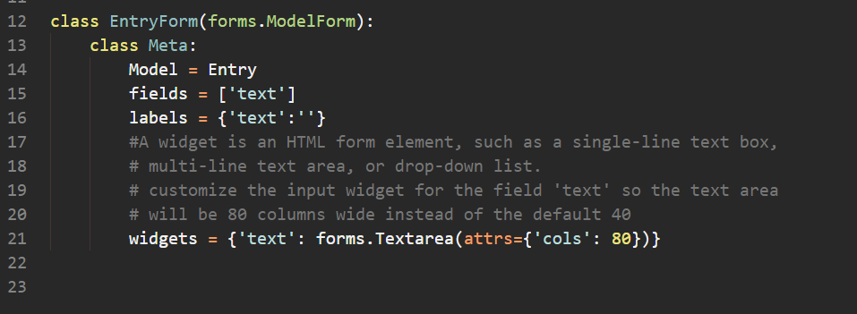
Create the form

Slide 3
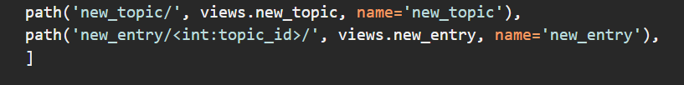
Define the URL

Slide 4
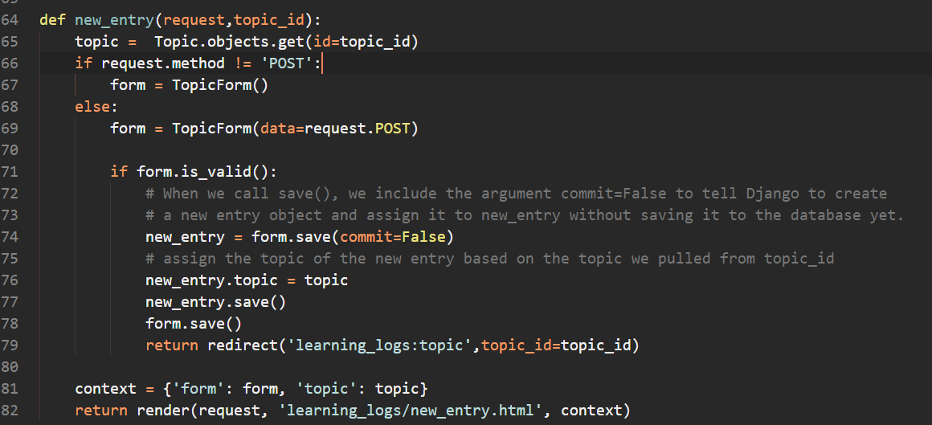
Define the Function

Slide 5
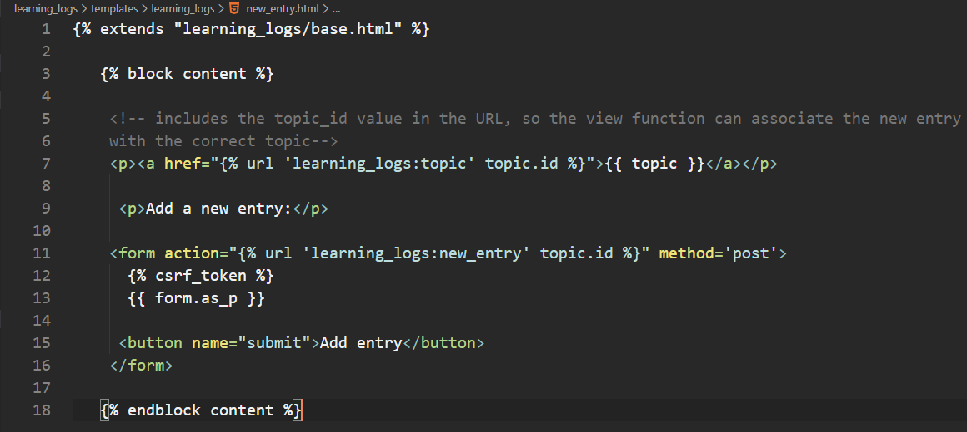
Define the Template

Slide 6
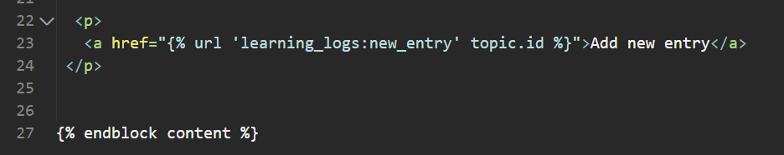
Linking to the new_entry Page
we need to include a link to the new_entry page from each topic page in the topic template:

Slide 7
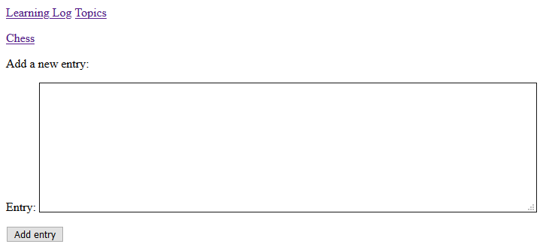
New Entry

Slide 8
Editing Entries
The edit_entry URL
The edit_entry() View Function
The edit_entry Template
Linking to the edit_entry Page

Slide 9

The edit_entry URL

Slide 10

The edit_entry() View Function

Slide 11
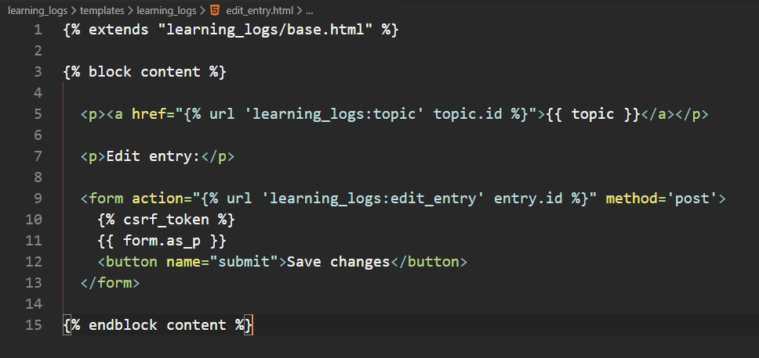
The edit_entry Template

Slide 12
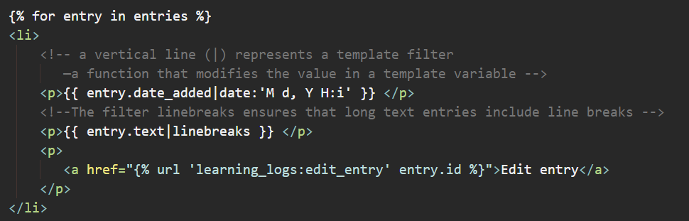
Linking to the edit_entry Page

Slide 13
Setting Up User Accounts

